Slide 1
PRESS ACCREDITATION LA2028
Lausanne, 4 December 2025

Slide 2
General overview of press accreditation
IOC Media Operations manages the press accreditation process
The allocation and distribution of press accreditations within each country are managed by the respective National Olympic Committees.
Every two years before the Games each NOC receives a press accreditation quota allocated by IOC Media Operations
This allocation should be redistributed to the written press and photographers in the NOC's territory.
A limited number of non-media rights holding television and radio accreditations are also available.
NOCs may also be allocated a certain number of NOC E press attaches.
The press accreditation quota allocated to each NOC is determined by the IOC Press Allocation Working Group taking into accounts various parameters.

Slide 3
NOC Quota Distribution
NUMBER of athletes
NUMBER of Sports
NUMBER of medals
NUMBER of “E” accreditations
Proximity with host country
LOCAL media industry
Population & gdp

Slide 4
Press categories
Category | Population | Venue Access | Zone Access
E | Journalist | All Sport Venues, MPC | 4, White
Es | Sport Specific Journalist | Own Sport Venues, MPC | 4, White
EP | Photographer | All Sport Venues, MPC | 4, White
EPs | Sport Specific Photographer | Own Sport Venues, MPC | 4, White
ET | Technician | All Sport Venues, MPC | 4, White
EC | Support Staff | MPC | White
ENR | Non rights holding broadcaster | All Sport Venues | 4, White
Ex | Local National Press | To be determined | 4, White
EPx | Local National Photographer | To be determined | 4, White
*NOC E | NOC Press Attaché | All Sport Venues, MPC | 4, Blue, MZ
*NOC Es | Sport Specific NOC Press Attaché | Own Sport Venues, MPC | 4, Blue, MZ

Slide 5
Press accreditation categories description
Code | Description
E | JOURNALIST: Journalist, editor, photo editor, employed or contracted by a world news agency, a national agency, a general daily newspaper, a sports daily, a sports magazine, internet site and social media platform or independent/freelance journalist.
Es | SPORT SPECIFIC JOURNALIST: Journalist specialised in a sport. The Es accreditation will include access to all disciplines of that sport.
EP | PHOTOGRAPHER: Photographer, meeting the same criteria as those defined for category “E”.
EPs | SPORT SPECIFIC PHOTOGRAPHER: Photographer specialised in a sport. EPs will include access to all disciplines of that sport.
ET | TECHNICIAN: Technician. ET accreditations are limited to technical support personnel of major news agencies, organisations and/or photo agencies and are generally identified by those organisations that rent Rate Card and telecommunications equipment at the MPC and competition venues.
EC | SUPPORT STAFF: Support staff of an accredited press organisation (office assistant, secretary, interpreter, driver etc). Access to the Main Press Centre (MPC) only. Assigned only to an accredited press organisation or other entity which have reserved a private office area at the MPC.
ENR | NON-MEDIA RIGHTS HOLDING BROADCAST ORGANISATION: Non-media rights holding radio and/or television organisation (non-MRH). ENR accreditations are only allocated by the IOC in consultation with the NOC. It is strictly prohibited for an NOC to grant a member of a non-MRH organisation any type of “E” category accreditation.
NOC E | PRESS ATTACHE: Press Attaché and /or NOC Communications staff producing written content (excluding audio/video) for the NOC’s official platform for editorial purposes only.
NOC Es | SPORT SPECIFIC PRESS ATTACHE: Press Attaché and /or NOC Communications staff producing written content (excluding audio/video) for the NOC’s official platform for editorial purposes only for one specific sport specific.

Slide 6
General overview of press accreditation
Press accreditation is a two-step process
Press by Number: NOCs have to submit the name of the organisations that they would like to accredit along with the corresponding quota to the Organising Committee
Press by Name: NOCs have to submit the details of every accredited person (passport, photo etc) to the Organising Committee
Press accreditation for the Olympic Games is granted exclusively to media professionals who meet the eligibility requirements.
The following individuals or entities are not eligible for press accreditation:
- Publishers and marketing personnel
- Athlete management companies
- Individuals representing athletes
- Advertising, public relations and promotion agencies
- Commercial partners associated with NOCs
- Government ministries and/or organisations

Slide 7
NOC E Press attaches
The NOC E press accreditation category is specifically designed for National Olympic Committees and was introduced at Paris 2024.
Eligibility Criteria:
NOC press attachés who act exclusively as press attachés for their own NOC
NOC Communications staff who produce written content (excluding video/audio) solely for official NOC platforms and strictly reserved for editorial purposes only.
National Federations are only eligible if acting directly as press attachés for the NOC.
Not Eligible:
Professional journalists or photographers, who must apply under the E (journalist) or EP (photographer) categories. Any attempt to apply under the wrong category will result in automatic rejection by the IOC.
Any other NOC staff not involved in Communications, including those assigned to NOC Hospitality Houses during the Games, are not eligible.

Slide 8
NEW! Media Registration Platform
For LA 2028, the IOC intends to launch a Media Registration Platform.
Media representatives wishing to obtain press accreditation to cover the Games for LA 2028 should submit their requests through this platform.
This initiative aims to ensure a consistent, fair and transparent press accreditation process across all territories.
The platform link will be available on www.olympics.com
NOCs should communicate this link when they launch their press accreditation process.

Slide 9
NEW! Media Registration Platform
Each NOC will have access to the back end of the platform and will be solely responsible for handling ALL requests originating from their own territory only.
The NOC will remain responsible for the management of these requests.
The IOC will have visibility of the requests but will not be involved in managing, performing quality control or engaging with any of the media outlets that apply.
Specific timelines to be discussed with the NOCs.
The Press by Number and Press by Name procedures will continue to follow the same process as previous Games, based on the quota assigned by the IOC in July 2026, and will be managed by the OCOG.
The IOC will need to approve the Press by Number forms submitted to the OCOG.

Slide 10
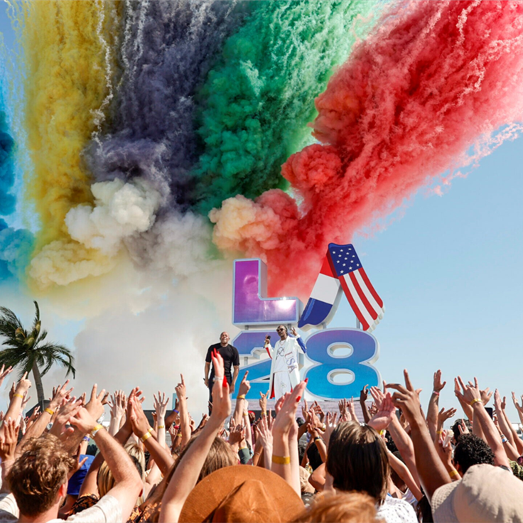
TENTATIVE timelines
July 2026 NOCs will receive their press accreditation quota from the IOC
August 2026 Press Accreditation Platform will open for applications from interested media
31 October 2026 Press Accreditation Platform closes
18 December 2026 OCOG Deadline for Press by Number submission
30 March 2027 OCOG deadline for accredited press outlets to submit their interest in obtaining Press Accommodation

Slide 11
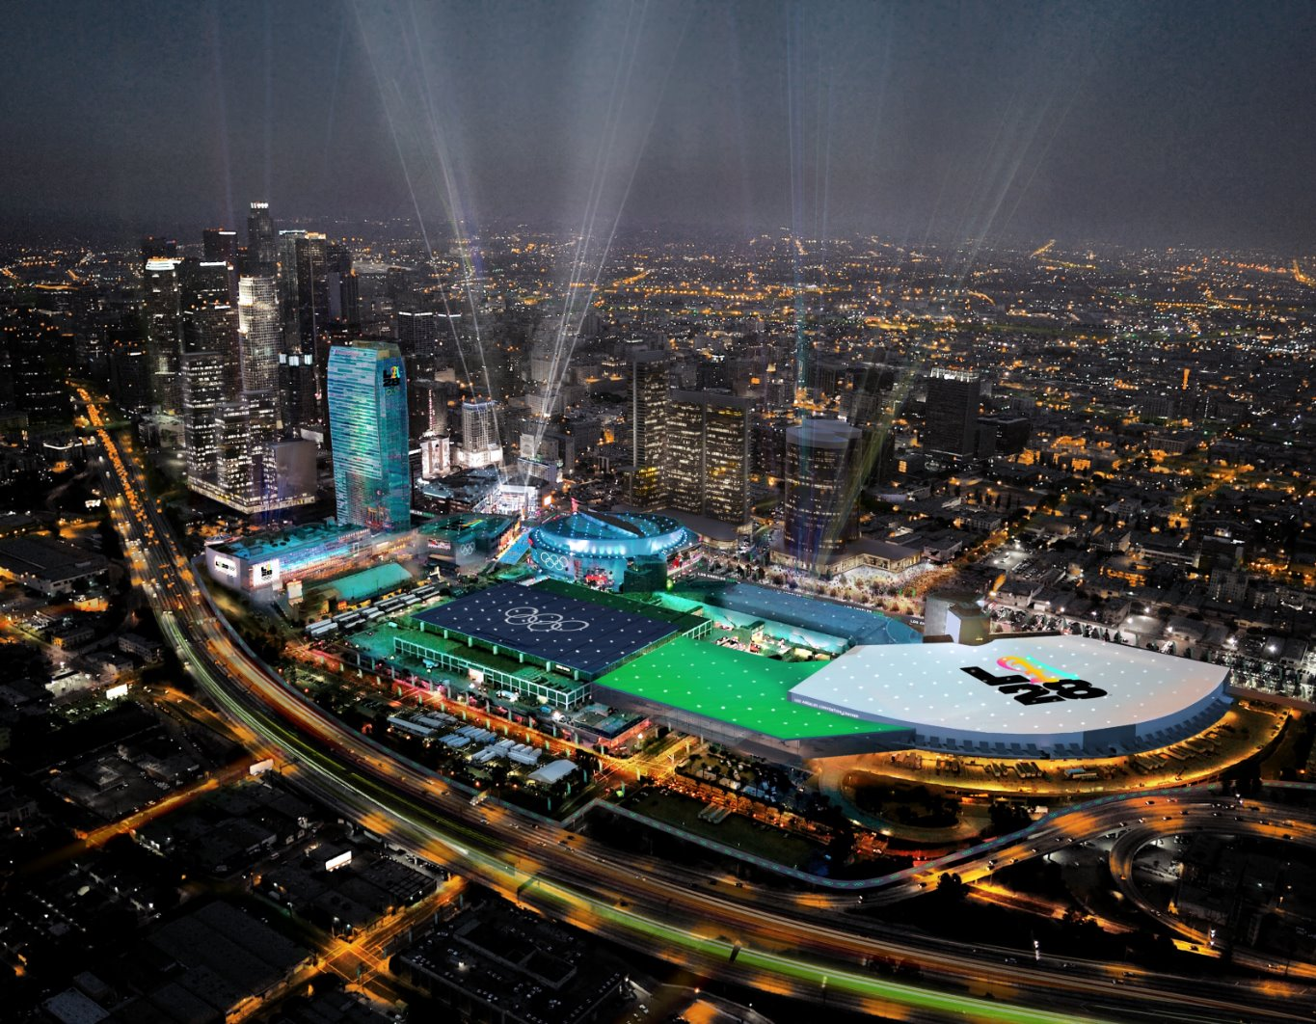
Press Accreditation GUIDELINES
Revised Terms & Conditions for press accreditation.
Procedures for how press accreditations are distributed by NOCs.
Press by Number Control measures.
Quota allocation and use of NOC E.
No show policy.
Code of conduct for accredited photographers along with guidelines for NOCs on selecting photographers

Slide 12
NOC E Quota
The NOC E quota has steadily increased with every edition of the Games.
Moving forward, the quota will be calculated exclusively using a fixed formula based on the number of athletes and sports per NOC.
Quota established in cooperation with IOC NOC Relations.
For example, an NOC participating in a single sport will be allocated one sport-specific NOC E only.
Although the number of NOC E quotas will decrease for larger NOCs, these quotas will become transferable.

Slide 13
Thank you. QUESTIONS?

